Slide 1

SCALA

Slide 2
Contents
Concurrency Overview
Futures
Handling Failures

Slide 3
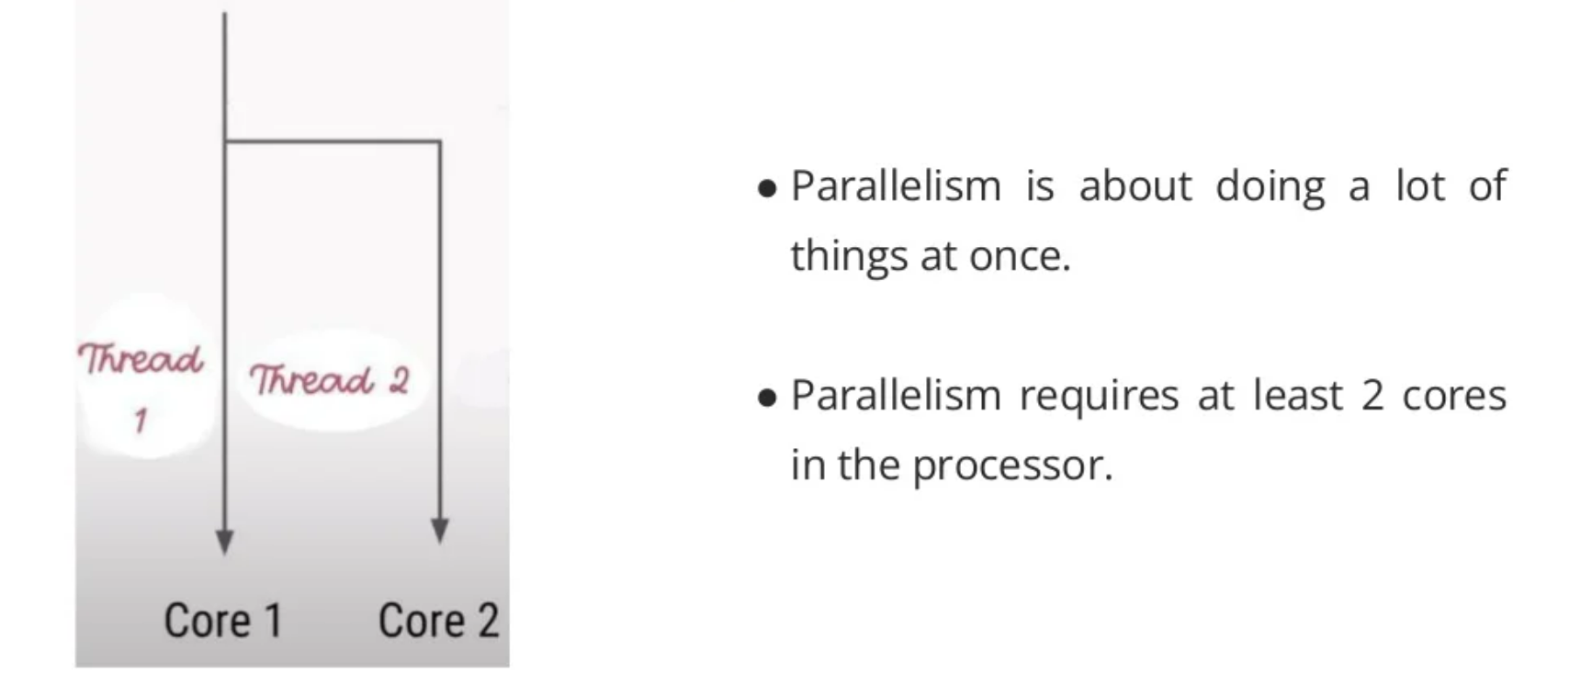

Slide 4
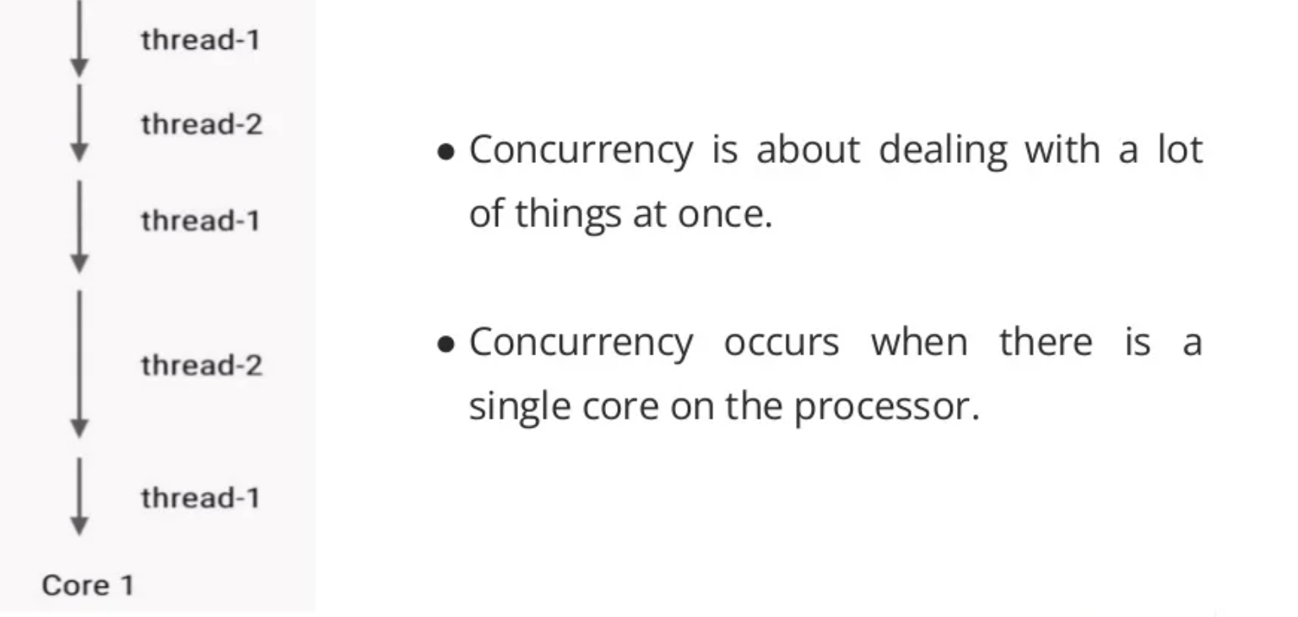

Slide 5
Concurrency Overview
Concurrency is when more than one task can start and complete in overlapping time periods.
It doesn’t matter whether they’re running at the same instant.
You can write concurrent programs on a single CPU (single execution core) machine where only one task can execute at a given point of time.

Slide 6
Typically multiple tasks are executed in a time-slice manner, where a scheduler (such as the JVM) will guarantee each process a regular “slice” of operating time.
This gives the illusion of parallelism to the users. And the common de facto standard way to implement a multitasking application is to use threads.

Slide 7
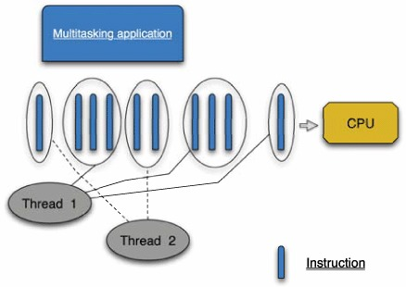
Figure shows how a multitasking application shares a single CPU.

Slide 8
As you can see in figure, two threads are executing instructions generated by the application in a time-sliced manner.
The group of instructions varies in size because you don’t know how much code will be executed before the scheduler decides to take the running thread out and give another thread the opportunity to execute.
Remember that other processes running at the same time might need some CPU time—you can see it’s pretty unpredictable.

Slide 9
Sometimes schedulers use a priority mechanism to schedule a thread to run when there’s more than one thread in a ready-to-run state.
Things become more interesting when you have code that blocks for resources, such as reading data from a socket or reading from the filesystem.
In this case, even though the thread has the opportunity to use the CPU, it can’t because it’s waiting for the data, and the CPU is sitting idle.

Slide 10
FUTURES
When you want to write parallel and concurrent applications in Scala, you could still use the native Java Thread — but the Scala Future makes parallel/concurrent programming much simpler, and it’s preferred.
Here’s a description of Future from its Scaladoc:
“A Future represents a value which may or may not currently be available, but will be available at some point, or an exception if that value could not be made available.”

Slide 11

Thinking in futures
To help demonstrate this, in single-threaded programming you bind the result of a function call to a variable like this:
With code like that, the value 42 is bound to the variable x immediately.

Slide 12

When you’re working with a Future, the assignment process looks similar:
But because aLongRunningTask takes an indeterminate amount of time to return, the value in x may or may not be currently available, but it will be available at some point (in the future).

Slide 13
A Scala Future is used to create a temporary pocket of concurrency that you use for one-shot needs.
You typically use it when you need to call an algorithm that runs an indeterminate amount of time — such as calling a web service or executing a long-running algorithm — so you therefore want to run it off of the main thread.

Slide 14
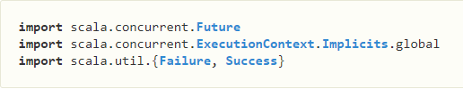

To demonstrate how this works, let’s start with an example of a Future in the Scala REPL. First, paste in these import statements:
Now, you’re ready to create a future. For example, here’s a future that sleeps for ten seconds and then returns the value 42:

Slide 15

While that’s a simple example, it shows the basic approach: Just construct a new Future with your long-running algorithm.
Because a Future has a map function, you use it as usual:
Initially this shows Future(<not completed>), but if you check b’s value you’ll see that it eventually contains the expected result of 84:

Slide 16

Notice that the 84 you expected is wrapped in a Success, which is further wrapped in a Future.
This is a key point to know: The value in a Future is always an instance of one of the Try types: Success or Failure. Therefore, when working with the result of a future, use the usual Try-handling techniques, or one of the other Future callback methods.

Slide 17
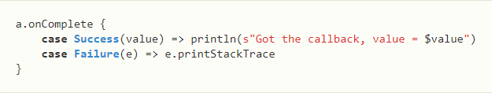

One commonly used callback method is onComplete, which takes a partial function in which you should handle the Success and Failure cases, like this:
When you paste that code in the REPL you’ll see the result:

Slide 18
Handling Failures
We have few techniques to handle failures in scala:
1) Option
Options handle both sides of the coin i.e both positive and negative. It uses Some(value) for the positive case and None for the negative case.
2) Try
Try is another technique to achieve functional purity. Try results in Success(value) or Failure(exception). Try is ideal when we are dealing with third-party libraries.

Slide 19
3) Either
Either also handles both cases as other techniques do but it is better than Option and Try.
Option has a demerit that it does not provide the error message in case of failures, it just returns None for the failures.
Try provides us a failure message for a failure but still, we need to throw an exception which we want to avoid.
Either is a good approach to avoid these. It returns Left or Right. Left contains the error message that we pass in our code and Right contains the value itself.

Slide 20
4) Third Party Libraries
There are many third-party libraries that can also be used to achieve the same

Slide 21
THANK YOU

